Slide 1
COMP 2400
Week 4 - Monday

Slide 2
Last time
What did we talk about last time?
Loop errors
System programming

Slide 3
Questions?

Slide 4
Project 2

Slide 5
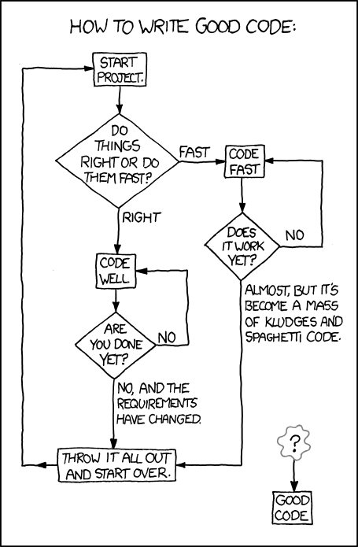
From:
https://xkcd.com/844/

Slide 6
Functions

Slide 7
Anatomy of a function definition
type name( arguments )
{
statements
}

Slide 8
Differences from Java methods
You don't have to specify a return type
  But you should
  int will be assumed if you don't
If you start calling a function before it has been defined, it will assume it has return type int and won't bother checking its parameters

Slide 9
Prototypes
Because the C language is older, its compiler processes source code in a simpler way
It does no reasonable typechecking if a function is called before it's defined
To have appropriate typechecking for functions, create a prototype for it
Prototypes are like declarations for functions
  They usually come in a block at the top of your source file

Slide 10
Prototype example
Parameter names in the prototype are optional (and don't have to match)
Both of the following work:
  int root(int);
  int root(int blah);
You can also declare a prototype locally (inside a function), but there isn't a good reason to do so
#include <stdio.h>
int root (int value); // Integer square root
int main()
{
  int output = root(19);
  printf("Value: %d\n", output);
  return 0;
}
int root (int value)
{
  int i = 0;
  while (i*i <= value)
  i++;
  return i – 1;
}

Slide 11
Insanity
If your function takes nothing, you should put void in the argument list of the prototype
Otherwise, type checking is turned off for the arguments
double stuff(void);
int main()
{
  double output =
  stuff(6.4, "bang"); // Error
  return 0;
}
double stuff();
int main()
{
  double output =
  stuff(6.4, "bang"); // Legal
  return 0;
}

Slide 12
Return values
C does not force you to return a value in all cases
  The compiler may warn you, but it isn't an error
Your function can "fall off the end"
Sometimes it works, other times you get garbage
int sum(int a, int b)
{
int result = a + b;
return result;
}
int sum(int a, int b)
{
int result = a + b;
}

Slide 13
Self defense
C allows terrible things:
  Functions without a return type
  Situations where nothing gets returned
  Uninitialized variables getting used
You can get warnings about these things and more by turning on all warnings in gcc with the -Wall flag:
Warnings won't stop your program from compiling, but you can investigate why they're happening
> gcc -Wall program.c -o program

Slide 14
Programming practice
Let's write a function that:
  Takes an unsigned integer as a parameter
  Returns the location of the highest 1 bit in the integer (0-31) or -1 if the integer is 0
Parameter | Return Value
0 | -1
2 | 1
3 | 1
2000 | 10
4294967295 | 31

Slide 15
More programming practice
Let's update the function from the lab so that it can read a double value
// Original function
int readInt()
{
int c = 0;
int i = 0;
while ((c = getchar()) != EOF && c != '\n')
{
if (c >= '0' && c <= '9')
i = i * 10 + (c - '0');
}
return i;
}

Slide 16
More programming practice
Write a function that checks whether an integer is a palindrome
141 and 666 are palindromes
123 is not a palindrome
Since you don't know how to convert an int to a string, that approach isn't available
Hint:
  Remove each 1's digit from the number and add it to another number, multiplying that number by 10 as you go
  If and only if the original was a palindrome, the new number will be equal to it

Slide 17
Upcoming

Slide 18
Next time…
Recursion
Variable scope

Slide 19
Reminders
Keep reading K&R chapter 4
Keep working on Project 2
  Due by midnight on Friday

